Slide 1
Identity: The Power of Language
Unpacking “Hispanic, Latinx, and Ch/Xicanx” To Better Serve Our Youth
Josie Valadez Fraire

Slide 2
Roadmap
Locating Myself
Current Understandings
Your identities
The “X”
Identities
  Hispanic
  Latinx
  Chicanx
  Xicanx
Takeaways
Final Thoughts – Dyad
Free Write/Exit Ticket
Tlazocamati

Slide 3
Locating Myself
Xicana/MeXICANA/Indígena
Cisgender, heterosexual muxer/womxn
First-generation college student/graduate
  University of Colorado Boulder: Class of 2016
Bilingual (Spanish/English - linguistic privilege)
Daughter of economic refugees/“immigrants”
  Boulder/México/Longmont
Working class
Able-bodied, struggle with anxiety
Passionate about equity and liberation, youth, serving marginalized and systemically underserved peoples

Slide 4
Current Understandings
Please write what comes to mind when you hear the following terms:
  Hispanic
  Latino/a
  Chicano/a
  Xicano/a
SHOW what comes to mind - Teatro

Slide 5
Your Identities
Please write down how YOU identify
Any and all identities you choose

Slide 6
The “X”
The “x” at the end of terms like Latinx, Chicanx, Xicanx
  Why I use it → Gender Inclusivity
  Languages (for ex. Spanish) inherently gendered
    LOS jovenes, estudiantes, etc.
      Lxs jovenes…
  Resists and counters gender binary (female/womxn, male/man categorizations)
    Inclusive to all gender identities, including people who identify as trans*, gender non-conforming, agender, genderfluid, and genderqueer

Slide 7
“Hispanic”
Origin
  Invented umbrella term
  Used in 1970 census to categorize people of “Latin origin”
  Became standardized identity
    Imposed
Meaning
  Roots origins of Brown peoples in Spain (colonizer of many peoples)
  Erases indigeneity
Current Understandings
  Many identify as such
  Many White folks still use it, Brown folks identify with
    Why might this be?

Slide 8
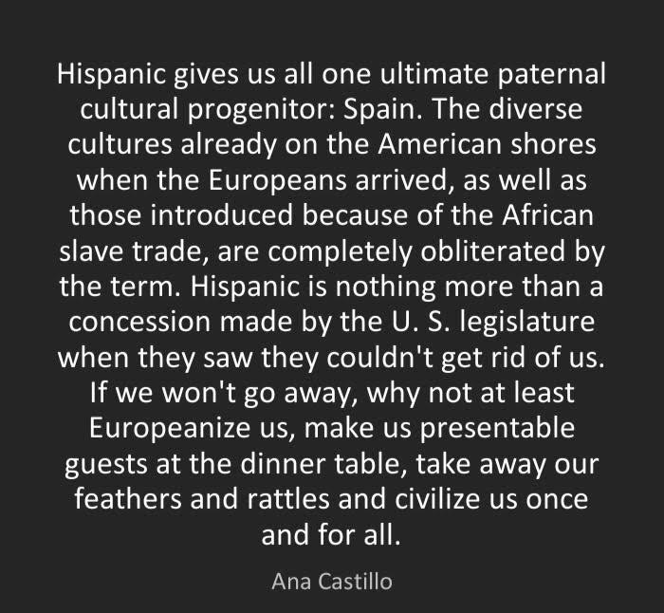
“Hispanic”

Slide 9
Latinx
Umbrella Term (U.S.)
Better term?
  Hispanic vs. Latinx (often used interchangeably)
  Many prefer “Latinx”
Still roots origins in “Latin” contexts
  Negates indigeneity
  Imposes colonized identities
  Not just “Latin America”
Reflects identity based on usage of colonized language
  Spanish, Portuguese, French, etc.
  Names us according to colonization
Not inclusive to non-Brown presenting people

Slide 10
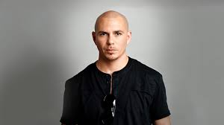
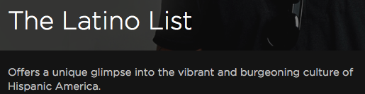
Latinx
Cubano
Male
Very light skinned
Google images
  “Latino”
  HBO Documentary

Slide 11
Chicanx
Origin
  Nahuatl?
Largely popular due to Chicano Movement
Mexican-Americans
  Not all – more inclusive term
Self-identification
Used often Term often stigmatized within communities
  “White-washed” identity
  Viewed as refusing Mexican/U.S. “American” identities
Navigating complexities of identity in the U.S.

Slide 12
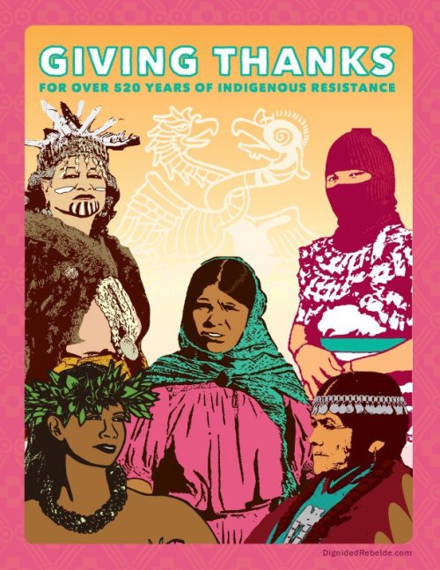
Xicanx
“X” used to reclaim indigeneity
  Nahuatl
Heavily political/radical identity
More inclusive
  Brown folks within African diaspora
    “Afro-Latinx”
  Any variation of Brownness
Disrupts current understandings of racial/ethnic categorization
Self-identification
Dignidad Rebelde

Slide 13
Takeaways
More than just about terms
Identities are socially constructed
Each student will identify differently
  ASK THEM
Work to be inclusive and affirming NOT just tolerant/ “respectful”
  Curriculum (not just immigration!)
  Pedagogy
  Dismantle White Supremacy

Slide 14
Final Thoughts - Dyad
What feelings came up as you listened to the presentation?
New learning or AHA’s? Did you thinking about labels change in any way?
What can you take back to your classroom or school? How can you apply this knowledge to your pedagogy to better serve your students?

Slide 15
Free Write/Exit Ticket
Please take 2-3 minutes to write down any final thoughts or questions!
Use the identity you wrote down at the beginning as an anchor for your understandings
  Do you think your identity is relevant to your teaching practices?

Slide 16
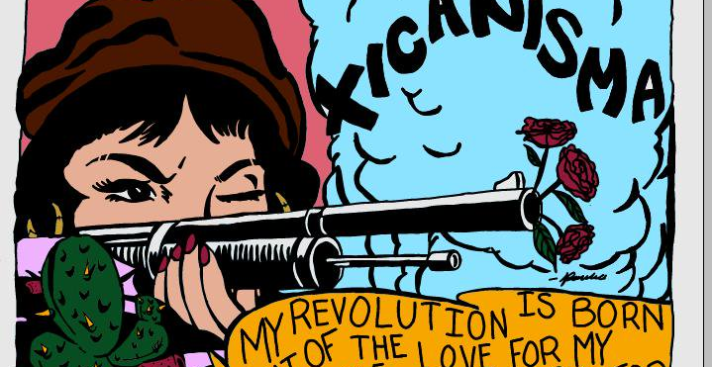
Tlazocamati/Thank You
Pancha

