Slide 1
Veterans Day:
Celebrating Diversity
Diverse Veterans in American History and Colorado’s Latino History

Slide 2
Veterans Day: Celebrating Diversity
Lesson Plan Author: originally prepared by Kent Willmann, University of Colorado at Boulder School of Education; modified by Marjorie McIntosh
Grade Level: Any
Time Required: 15 minutes to 2 hours or more
BCLHP Unit: Several
Topic: Veterans and Veterans Day
Tags & Keywords (5 minimum 10 maximum): Veterans, WWI, WWII, Vietnam, Veterans Day, Military, Diversity, Armed Services, Army, Diversity
Lesson Summary (50 words or less): Veterans Day is used to explore diverse contributions to the American Armed Services across time. The history of Veterans Day and Colorado Latino veterans’ stories are highlighted. An analysis tool relating documents to Veterans themes is included. Extensions include choices for students to explore veterans’ history.

Slide 3
Veterans Day: Celebrating Diversity
Step-by-Step Procedures
Handout note taking form to students. Explain each of the boxes.
Ask students what what they know about veterans and/or Veterans Day. This could be used as a pre/post test.
Ask students to define the 3 Veterans Day Power Words: Honor, Patriotism, Service. Why do we associate these words with Veterans?
Tell students that they are going to learn some history of Veterans Day, some stories about diverse veterans and some local Latino Veteran History. Also tell them that they may get a chance to learn more on their own.
Show the slides. You or another student can read the text with each slide. Pause frequently to allow students note taking time. Feel free to expand or contract the amount of information shared on each slide.
If you choose, you can extend the lesson by doing the Relating Documents to a Veterans Day theme. A list of web sites for a follow-up research extension are included. Another extension would be to invite a panel of Veterans to your classroom to discuss their experiences.

Slide 4
Veterans Day Name_____________________ History of Veterans Day 3 Details 1. 2. 3. | Write 4 words and/or draw 4 images that stick in your mind | HIstorical Diverse Veteran Stories Select 2 1. 2.
Colorado Latino Veteran Stories Select 2 1. 2. | In what ways are these Power Words associated with veterans? Honor Patriotism Service | My Extension Plans What do you want to learn more about? Please circle one Family Military History? Veterans Monuments & Memorials? Celebrating Diverse Veterans History? Local Latino Connections? Other Local Connections?
Student Note Taking Form

Slide 5
Veteran’s Day Power Words
Ask student to share how what they think these words mean in a Veterans Day context.
Honor
Patriotism
Service

Slide 6
History of Veterans Day
History Channel - Click Here for more from the History Channel
*Veterans Day originated as “Armistice Day” on Nov. 11, 1919, the first anniversary of the end of World War I. Congress passed a resolution in 1926 for an annual observance, and Nov. 11 became a national holiday beginning in 1938.
*Veterans Day is not to be confused with Memorial Day–a common misunderstanding, according to the U.S. Department of Veterans Affairs. Memorial Day (the fourth Monday in May) honors American service members who died in service to their country or as a result of injuries incurred during battle, while Veterans Day pays tribute to all American veterans–living or dead–but especially gives thanks to living veterans who served their country honorably during war or peacetime.
*In 1954, President Eisenhower officially changed the name of the holiday from Armistice Day to Veterans Day.
*In 1968, the Uniform Holidays Bill was passed by Congress, which moved the celebration of Veterans Day to the fourth Monday in October. The law went into effect in 1971, but in 1975 President Ford returned Veterans Day to November 11, due to the important historical significance of the date.
.
.

Slide 7
VETERANS STATISTICS
The brave men and women who serve and protect the U.S. come from all walks of life; they are parents, children and grandparents. They are friends, neighbors and coworkers, and an important part of their communities. Here are some facts about the current veteran population.
There are 23.2 million military veterans in the U.S.
9.2 million veterans are over the age of 65.
1.9 million veterans are under the age of 35.
1.8 million veterans are women.
7.8 million veterans served during the Vietnam War era (1964-1975), which represents 33% of all living veterans.
5.2 million veterans served during the Gulf War (representing service from Aug. 2, 1990, to present).
2.6 million veterans served during World War II (1941-1945).
2.8 million veterans served during the Korean War (1950-1953).
6 million veterans served in peacetime.
As of 2008, 2.9 million veterans received compensation for service-connected disabilities.
5 states have more than 1 million veterans in among their population: California (2.1 million), Florida (1.7 million), Texas (1.7 million), New York (1 million) and Pennsylvania (1 million).
The VA health care system had 54 hospitals in 1930, since then it has expanded to include 171 medical centers; more than 350 outpatient, community, and outreach clinics; 126 nursing home care units; and 35 live-in care facilities for injured or disabled vets.

Slide 8
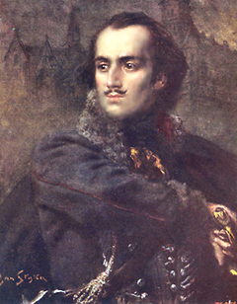
Celebrating Diversity: Veterans’ Stories
Revolutionary War
Casimir Pulaski from Poland
Casimir Pulaski {1745–1779), a Revolutionary War cavalry officer born in Poland as Kazimierz Pułaski. He is praised for his contributions to the U.S. military in the American Revolution and known as "the father of the American cavalry".
He distinguished himself throughout the revolution, most notably when he saved the life of George Washington. Pulaski became a general in the Continental Army, created the Pulaski Cavalry Legionand reformed the American cavalry as a whole. At the Battle of Savannah, while leading a daring charge against British forces, he was gravely wounded, and died shortly thereafter.
The first Monday in October is Pulaski Day in Illinois. It is mostly celebrated by the large number of residents of Polish heritage.

Slide 9
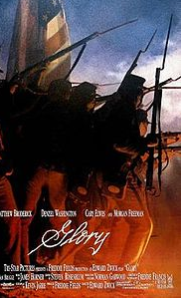
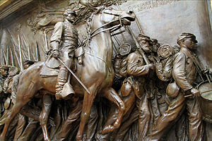
Celebrating Diversity: Veterans’ Stories
African Americans in the Civil War
54th Massachusetts Volunteer Infantry
The first formal all African American fighting force in the Civil War.
They were the first unit of what became known as the United States Colored Troops and known for their heroic actions at Fort Wagner. it was commissioned after the passage of the Emancipation Proclamation.Secretary of War Edwin M. Stanton decided white officers would be in charge of all "colored" units. Andrew selected Robert Gould Shaw to be the regiment's colonel
The story of the regement is told in the film Glory and in a bronze statue on Boston Common.

Slide 10
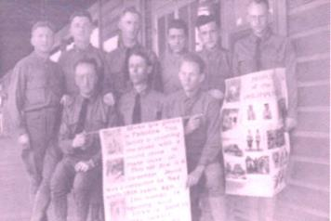
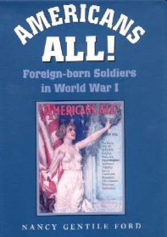
Celebrating Diversity Veterans’ Stories
WWI - Immigrant Soldiers
During the First World War, the U.S. government drafted into military service nearly half a million immigrants of forty-six different nationalities, creating an army with over 18 percent of its soldiers born in foreign countries. In addition, thousands of second-generation "immigrants" also served.
This new influx of Old World soldiers challenged the cultural, linguistic, and religious traditions of the American Army and forced the military to reexamine its training procedures.
Here German-Americans use pictures to learn English after enlisting in the Army for WWI

Slide 11
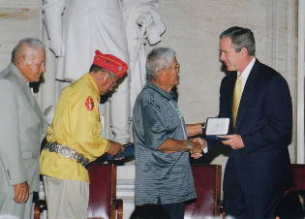
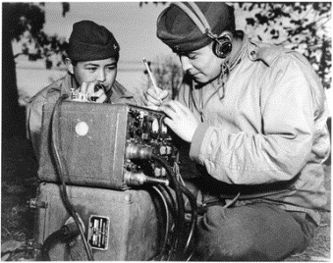
Celebrating Diversity: Veterans’ Stories
Navajo Code Talkers WWII
The beginning of the Navajo Code Talkers began on May 4, 1942 when 29 recruits were placed aboard a bus and transported to San Diego, California for Marine Corps training. The program was originally established in September gearing to create a code language that had no written alphabet or documentation. Navajo males between the ages of 17 and 32 were recruited. Some leaving their native land for the first time to travel overseas on the front lines. After the ending of the war and returning in the United States, the existence of the Navajo Code Talker program was kept a secret for decades more.
Navajocodetalkers.org

Slide 12
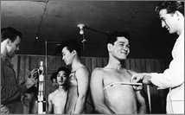
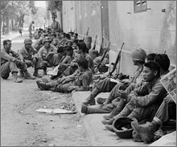
Celebrating Diversity: Veterans’ Stories
Japanese Americans in WWII
After Pearl Harbor, the Federal government took the unprecedented step of ordering some 110,000 Japanese aliens and American citizens of Japanese descent living along the West Coast out of their homes and into ten inland internment camps. In addition, all Japanese-American men of draft age, except those already in the armed forces, were classified as 4-C, enemy aliens, forbidden to serve their country.
Then, in early 1943, Washington reversed its policy on military service. The Japanese government had been making effective propaganda in Asia out of the internment of Japanese Americans in the U.S.; the camps appeared to confirm their depiction of the war as a racial conflict. To respond to the Japanese propaganda, and under pressure from Japanese American and civil liberties organizations, President Roosevelt authorized the enlistment of Japanese-American men into the U.S. Armed Forces.
Japanese Americans were now permitted to form a special segregated infantry outfit – the unit would come to be called the 442nd Infantry Regimental Combat Team. In Hawaii, where Japanese Americans had never been locked up, recruitment exceeded all expectations. When the Army called for 1,500 volunteers, 10,000 turned up at recruiting offices.
From PBS The War

Slide 13
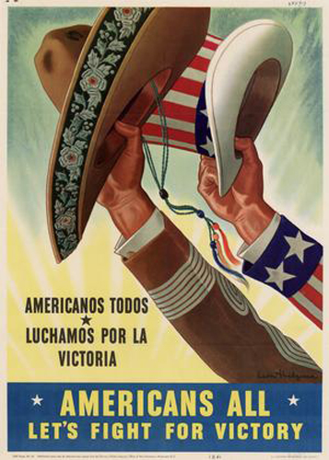
WWII Propaganda Poster
Los Veteranos: Latino Americans in WWII
Over 500,000 Latinos (including 350,000 Mexican Americans and 53,000 Puerto Ricans) served in WWII. Exact numbers are difficult because, with the exception of the 65th Infantry Regiment from Puerto Rico, Latinos were not segregated into separate units, as African Americans were. When war was declared on December 8, 1941, thousands of Latinos were among those that rushed to enlist. Latinos served with distinction throughout Europe, in the Pacific Theater, North Africa, the Aleutians and the Mediterranean. Among other honors earned, thirteen Medals of Honor were awarded to Latinos for service during WWII.

Slide 14
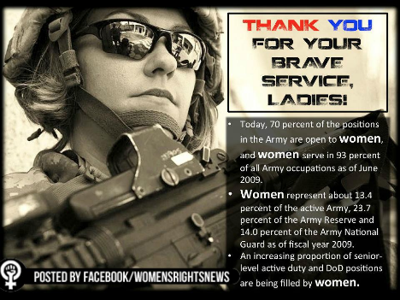
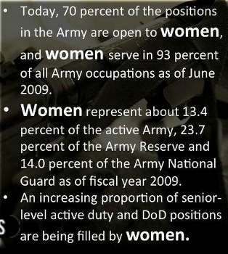
Celebrating Diversity: Veterans’ Stories
Women: Iraq & Afghanistan

Slide 15
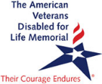
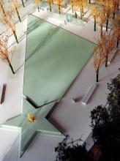
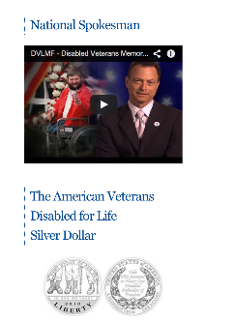
Celebrating Diversity Veterans’ Stories
The American Veterans
Disabled for Life Memorial
The newest memorial near the National Mall in Washington D.C. was dedicated October 5th 2014. Through the juxtaposition of granite and glass, the American Veterans Disabled for Life Memorial conveys a combination of strength and vulnerability, loss and renewal. At this sacred spot, all of us—sons and daughters, mothers and fathers, wives, husbands and friends—have the opportunity to learn the important lessons of courage, sacrifice, tenacity, loyalty and honor by bearing witness to the experiences of our heroes who are disabled.
Click here to watch a video about the dedication

Slide 16
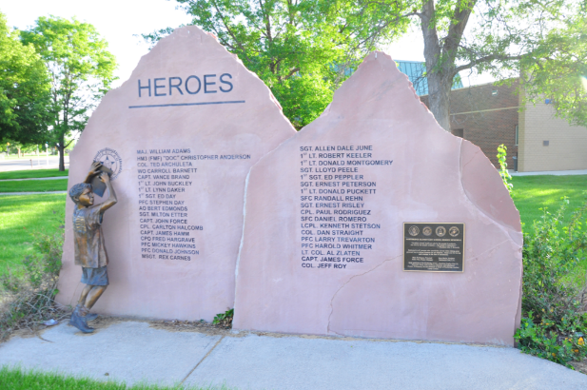
Local Latino Veteran Stories
Pride and Prejudice
Northridge
Elementary
School
Monument

Slide 17
Transcript, interview, Mary Gonzales Tafoya of Longmont, CO
Account of Albert Tafoya coming back wounded from WW II, wouldn't be served at hamburger place; brother Alex tore down"White Trade Only" signs; police called but sided with veteran. Good description of Korean War, with Mexicans and blacks sent to front first; later flashbacks for her husband, Richard Tafoya. Nice account of how Mary Gonzales met Richard Tafoya, picking beans and after his return from Korea. Richard was cement finisher. Mary's father Alex ran the City Cafe (restaurant) in Longmont.

Slide 18
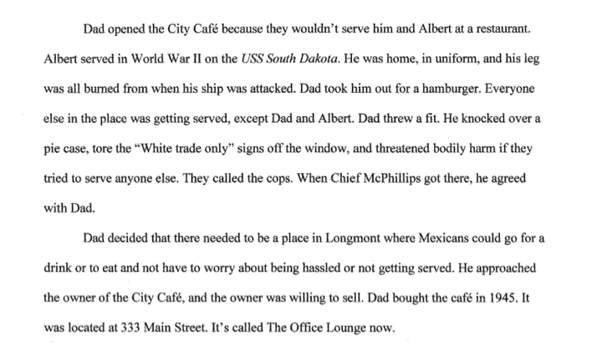
Veterans attack racism: Mary Gonzales Tafoya
http://bocolatinohistory.colorado.edu/document/transcript-interview-mary-gonzales-tafoya-p-2

Slide 19
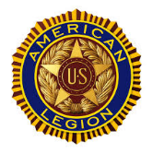
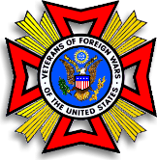
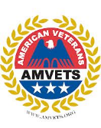
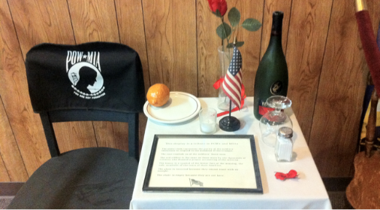
Local Veterans’ Stories
American Legion, VFW, and AMVETS are three national organizations that have local units. They provide a variety of services to veterans and our community including help with obtaining government services, honor guards and socialization. Many offer scholarships to local students.
The POW-MIA exhibit on the right is in a honored place at the Longmont American Legion Hall. Click here to learn more about the symbolism of the items.

Slide 20
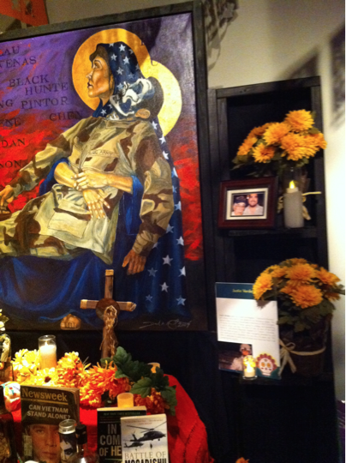
Local Latino
Veterans’ Stories
Dia Los Muertos
This display at the 2014 Longmont Museum’s Annual Dia Los Muertos Celebration was dedicated to veterans who gave their lives in service to our country.

Slide 21
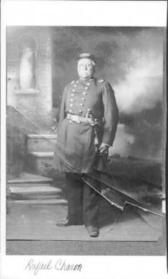
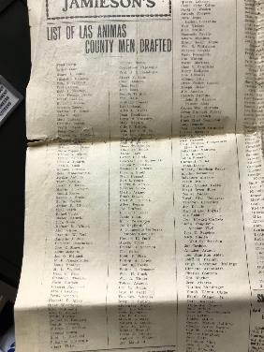
Colorado Veteran Images Rafael Chacon of Trinidad in military List of men drafted from Las Animas uniform, 1900-1910. He had previously County, 1917, with many Latino names fought on the Union side during the Civil War

Slide 22
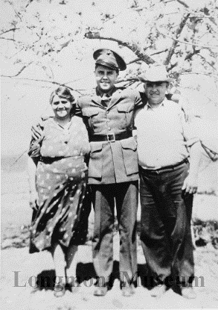
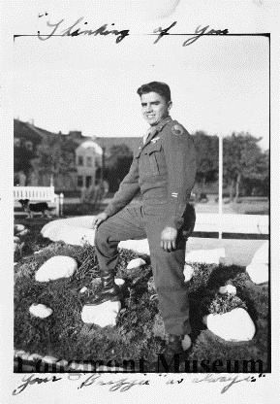
Colorado Veteran Images
Flavio (Floyd) Martinez in WWII and in uniform with parents.
The first image, from the Longmont Museum, shows a local soldier in uniform with his parents. The other image is the same soldier or his brother in Germany.

Slide 23
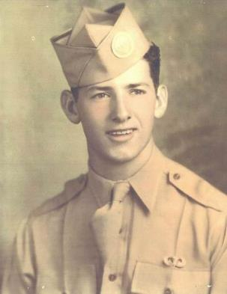
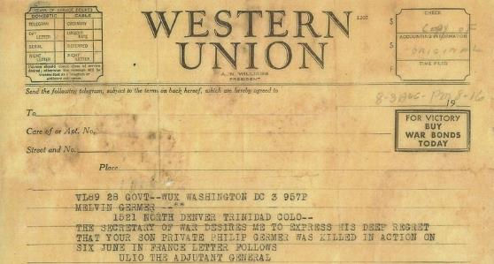
Philip Germer of Trinidad in uniform, 1942. He was a paratrooper in the 101st Airborne Division. Western Union telegram sent to Philip’s parents, Melvin Germer and Dora Lucero, announcing that he was killed in France during the D-Day invasion, June 6, 1944.

Slide 24
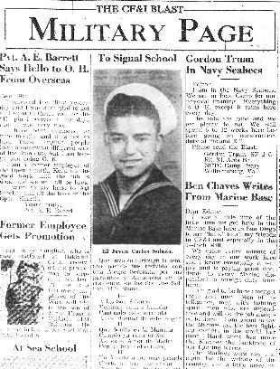
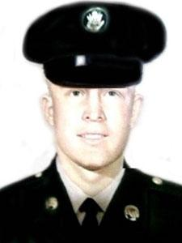
On left: photo and start of a long poem in Spanish about Carlos Solano of Pueblo, who was
starting at the Navy Signal School, 1943
On right: photo of Richard Romero of Pueblo, killed in action in Vietnam in 1968

Slide 25
Optional Activity: Relating Documents to a Veterans Day Theme
The next 3 slides are from from the Boulder County Latino History Project. Examine the photos. The all are from the same family and connect to veterans from WWI through Vietnam. How can you relate the themes of honor, patriotism and/or service to the photos?
Some key questions to think about as you examine the photos
What is in each photo? How is it related to veterans?
Why do you think the family chose to keep the photos?
Which word (honor, patriotism and/or service) best describes the photos.
Links to Archuleta Family Photos.
a. Image one - 3 boys by WWI Memorial
b. Image two - Archuleta Men in Military
c. Image three - Arthur Archuleta Newspaper clipping

Slide 26
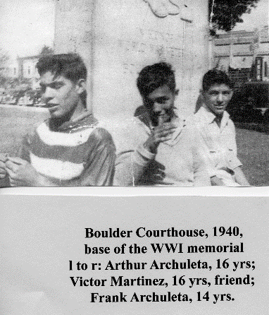
Local Latino Veteran Stories
Between WWI and WWII - WWI Memorial, Boulder County Courthouse
The memorial was erected to honor Boulder residents who served in WWI. Just like today, the Courthouse on Pearl street was a common place for people to hang out. Here two brothers and a friend relax. WWII had already started in Europe.

Slide 27
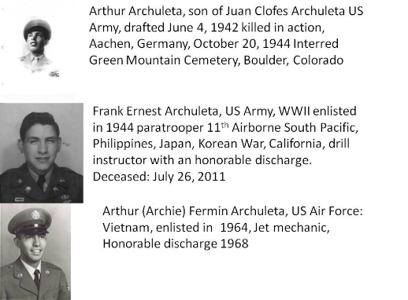
Local Latino Veteran Stories
WWII through Vietnam - Archuleta Family Veterans
These photos and captions were submitted to the Boulder County Latino History Project by the Archuleta family.

Slide 28
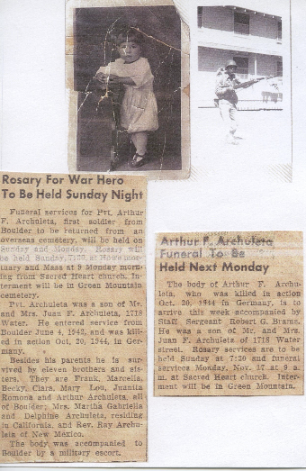
Local Latino Veteran Stories
Arthur Archuleta of Boulder, WWII soldier killed in action. His remains were returned from a cemetery in Germany.
The photos and newspaper clipping were submitted to the BCLHP by the family.
Click here to access that page.

Slide 29
Veterans Day - Connecting to You
1. Find a family photo of a veteran. Learn and record details of their service. What years? Locations? Rank? Duties? Awards?
2. Ask your parents or grandparents if they know any stories about veterans in your family. Ask to record what they remember.
3. Take a trip to a local veterans memorial. Examine the names on the memorial? Are there any Latino names? Write a report for your school to be shared on Veterans Day.
4. Learn about local veterans organizations. Contact
5. Go online to explore a topic or question about veterans that interests you.
6. Write a letter to a local veterans organization thanking them for their service.

Slide 30
For Teachers: Links for extensions
History of Veterans Day from Department of Veterans Affairs
Veterans Day Project
Veterans Day Library of Congress Primary Source Materials
History Channel Page
History of Veterans Day Videos
Latinos in WWI and WWII
Latinos and Latinas in WWII
Navajo Code Talkers
Japanese, African Americans and Latinos in WWII
Iraq and Afghanistan Veterans of America - Women’s page
Veterans Memorials Article from AAA Magazine
Boulder County Latino HIstory Project Search Page
Northridge elementary memorial
But this story—Born in Mexico, Killed in Iraq, and now honored with his name on a U.S. Navy war ship is pretty impressive. Check it out.
http://www.npr.org/2015/10/31/453393934/a-naval-ship-christening-in-the-name-of-a-fallen-war-hero

Slide 31
For teachers: The history of Veterans Day
Overview- Veterans Day is used to explore diverse contributions to the American Armed Services across time. The history of Veterans Day and Boulder County Latino veterans Stories are highlighted. A relating documents to Veterans themes is included. Extensions include choices for students to explore veterans’ history.

Slide 32
For Teachers: The history of Veterans Day
Standards &/or Objectives &/or Goal
Several multi-cultural veteran contributions to U.S. military history. Appreciation of contributions made by all kinds of people to American military.
Local Latino veteran contributions to U.S. military history.
Extensions offers opportunity for research into family military history or other topics of student interest.
High School Evidence Outcome
Examine and evaluate issues of unity and diversity from Reconstruction to present. Topics to include but not limited to the rise and fall of Jim Crow, role of patriotism, and the role of religion
Middle School Evidence Outcome
Evaluate the impact of different factors – on topics to include but not limited to gender, age, ethnicity and class– on groups and individuals in this time period and the impact of these groups and individuals on the events of the time period.
Elementary Evidence Outcome:
Describe the history, interaction, and contribution of the various peoples and cultures that have lived in or migrated to a community or region.

Slide 33
For teachers: The history of Veterans Day
Materials and Links: Embedded in slides

Slide 34
For teachers: The history of Veterans Day
Adaptations or Modifications
Students can be put into pairs to take notes
A student can take notes on a whiteboard or chart paper for other students to copy.
The teacher can select a single extension activity for all students to complete.
Measures of Learning
The note taking device can be collected and scored.
A short pre/post test asking student to list 5-10 things they know about Veterans Day can be given before and after the lesson.
The extensions activities can be used as evidence of learning.

